Slide 1
Maintain Enterprise Campus Network Architecture
CompTIA Security+ Exam SY0-701
Lesson 5
Notes:
So far we have covered general concepts, some of the main threat types, and the basis of access control systems. The next part of the course covers secure network architecture. This lesson covers on-premises networks, while Lesson 6 focuses on cloud and embedded systems.
Explain that architecture focuses on the purpose and placement of security controls. Later in the course we will cover the operational domain, which focuses on the proper configuration of controls.

Slide 2
Objectives
Compare and contrast security implications of different on-premises network architecture models
Apply security principles to secure on-premises network architecture
Select effective controls to secure on-premises network architecture
Ensure secure communications for remote access and tunneling

Slide 3
Enterprise Network Architecture
Lesson 5
Topic 5A
Notes:
The subobjectives for 3.1 and 3.2 are divided between this lesson and Lesson 6. This lesson collects the subobjectives that relate more to on-premises network architecture.

Slide 4
Architecture and Infrastructure Concepts
Selection and placement
  Infrastructure (media, appliances, addressing/forwarding for connectivity)
  Applications/services
  Data
Workflows
  Access
  Email mailbox server
  Mail transfer server
Notes:
Stress the point that the network is there to meet business goals. The network should be designed around business logic.

Slide 5
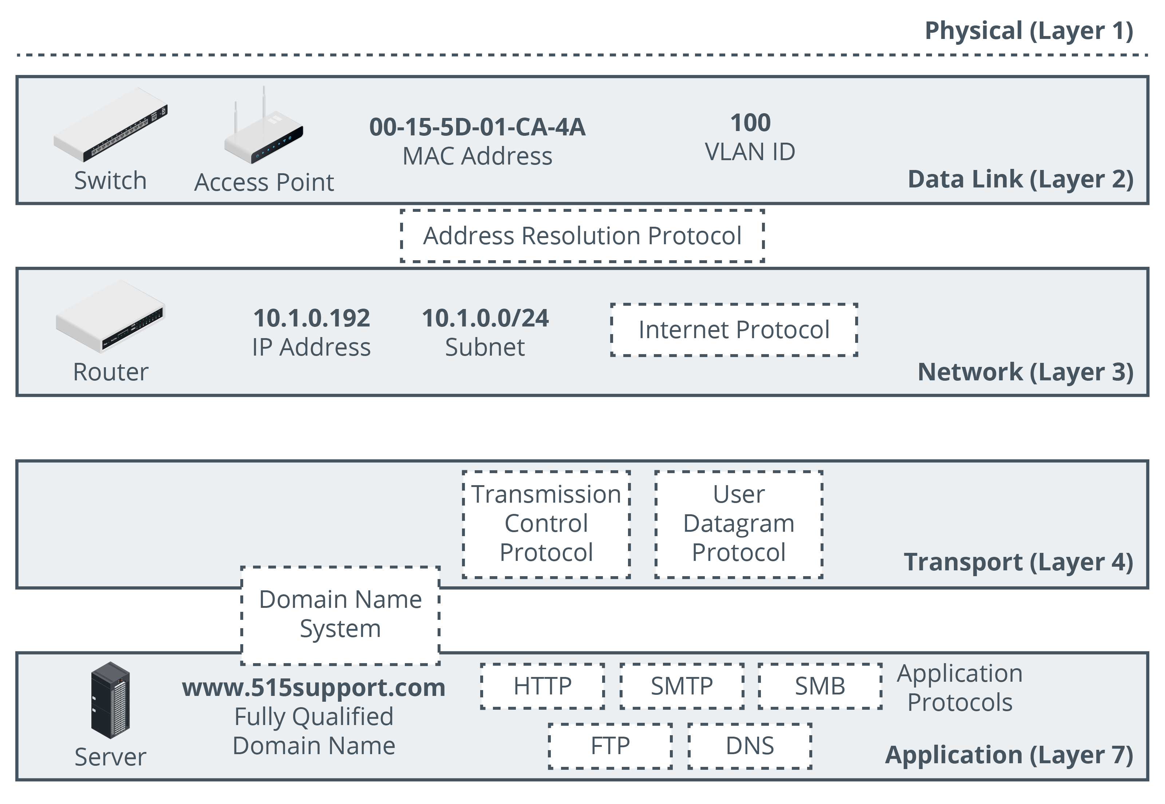
Network Infrastructure
Images © 123rf.com.
Notes:
This section is intended as a brief primer for students who have not completed Network+. You will not need to spend time on it otherwise.
The OSI model does get mentioned in the Security+ syllabus (in the context of firewall functionality) so students will need to know the layer IDs. We have omitted layers 5 and 6 from the diagram, however.

Slide 6
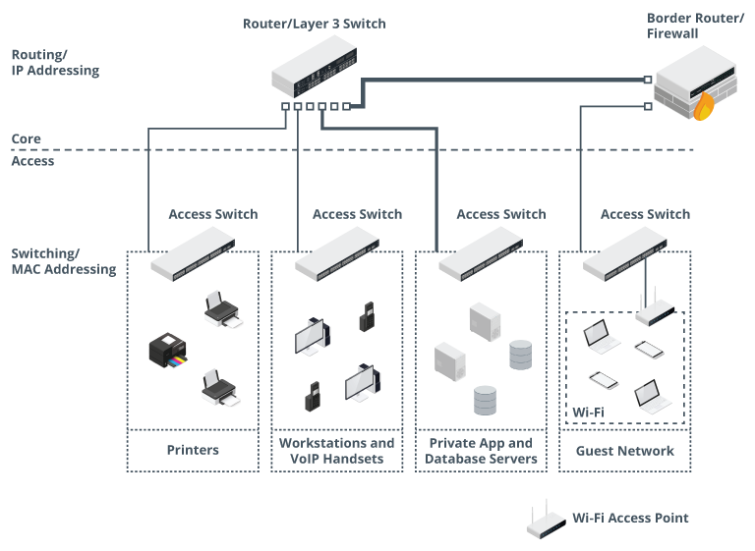
Switching Infrastructure Considerations
Topology of nodes and links
  Physical versus logical
On-premises networks
  Office/campus
  Structured cabling
Hierarchical design
  Limit size of broadcast domains
  Enforce segmentation
Images © 123rf.com.
Notes:
This is more background information for students who haven't completed Network+.

Slide 7
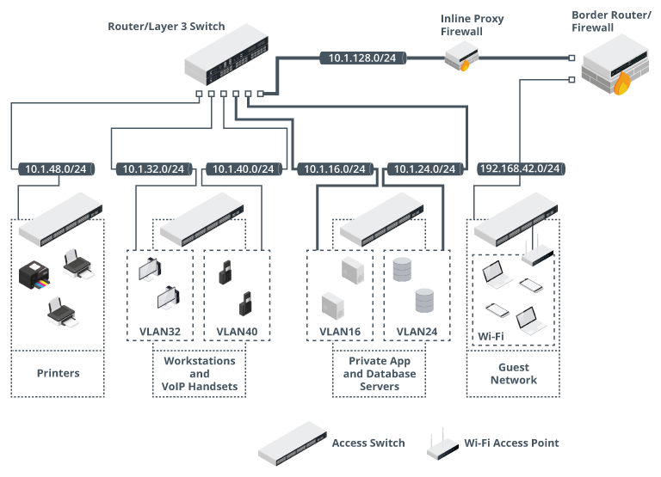
Routing Infrastructure Considerations
Layer 3 logical segmentation
  Networks and subnetworks (subnets)
Internet Protocol (IP)
  IPv4 and IPv6
  Network prefix/subnet mask
Virtual LAN (VLAN)
  Map layer 2 switch port topology to layer 3 IP subnet topology
  Makes logical topology independent of port location on physical switches
Notes:
This is the final part of the Network+ background information.

Slide 8
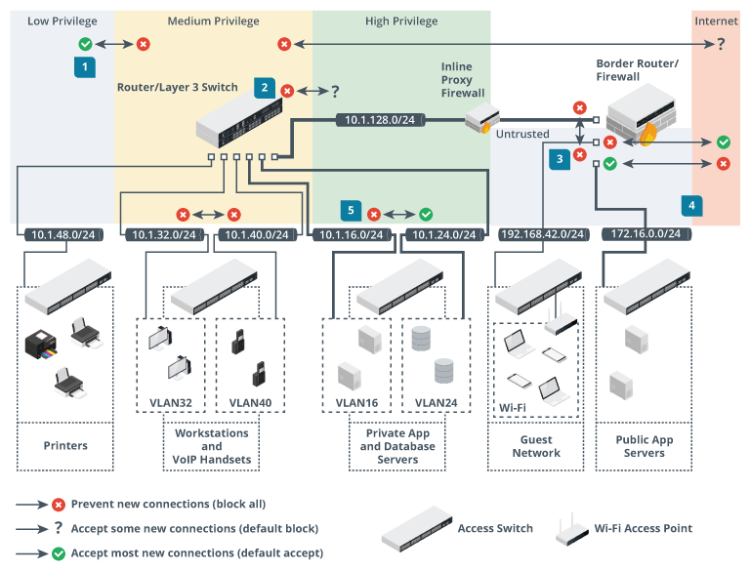
Security Zones
Segment containing hosts with same access control/security requirements
  Public versus private
  Database and file servers
    Compartmentalize different types of data assets
  Client devices
  Public-facing app servers
  Network infrastructure servers
Notes:
If students are struggling with the network terminology and functionality, summarize by pointing out that it basically gives you the ability to create lockable rooms and corridors.
The design part is deciding which assets should be stored in which rooms and who should have keys.
Optionally, point out that the assumption that hosts within a zone are trusted is not necessarily a secure one. This weakness is addressed by zero-trust security models. We'll cover these in the next lesson.

Slide 9
Attack Surface
Points at which threat actor can gain access
  Layer 1/2 versus layer 3 versus layer 4/7
Defense in depth and layered security controls
What problems arise from weaknesses in the network design/architecture?
  Single points of failure
  Complex dependencies
  Availability over confidentiality and integrity
  Lack of documentation and change control
  Overdependence on perimeter security
Notes:
The porousness of perimeter-based security is prompting the rise of zero-trust/microsegmentation models. These are more prevalent and easier to apply in the datacenter and will be covered in the next lesson.

Slide 10
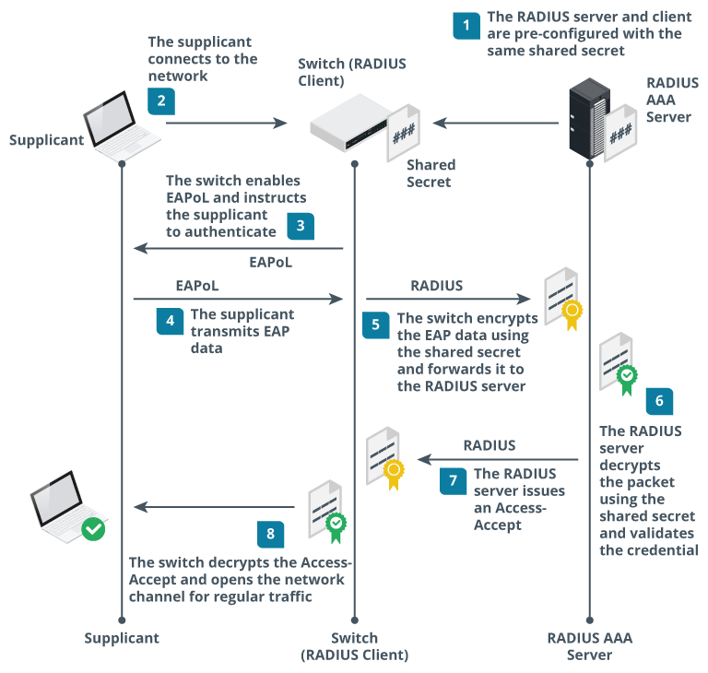
Port Security
Physical port security and administratively disabled ports
MAC filtering and limiting
802.1X, EAP, and RADIUS
  Supplicant (user’s computer)
  Authenticator/RADIUS client (switch)
  Authentication/RADIUS server
  IEEE 802.1X allows switches to implement EAP over LAN (EAPoL)
  Extensible Authentication Protocol (EAP) provides framework for authentication methods/factors
  Remote Authentication Dial-in User Service (RADIUS) allows use of a directory of user accounts and credentials
Notes:
Make sure students understand the difference between physical network ports and TCP/UDP application ports.
Make sure students understand why the switch shouldn't be able to process authentication decisions directly. Duplicating the user account database to access devices weakens security.
Check students understand the role of each standard/protocol:
* 802.1X is the standard that allows this AAA framework to work on Ethernet switches and Wi-Fi access points.
* EAP is the standard for packaging different types of credentials and notably allows credentials to be protected by digital certificate encryption.
* RADIUS allows the switch and authentication server to establish a trust relationship and exchange data securely.
You might want to note that EAP and RADIUS are used in other contexts, such as remote access VPNs.

Slide 11
Physical Isolation
Single host or group of hosts not connected to any other network
  Air gapped
Difficult to manage
  Updates via media devices

Slide 12
Architecture Considerations (1)
Cost
  Upfront capital cost and loss of value through depreciation
  Ongoing maintenance and support
Compute and responsiveness
  Reduce workload processing time
Scalability and ease of deployment
  Minimize costs associated with increasing (or decreasing) workloads
Notes:
Establish basic definitions of these performance characteristics. We'll be revisiting these throughout the course.

Slide 13
Architecture Considerations (2)
Availability
  Minimize downtime
Resilience and ease of recovery
  Reduce time taken to recover from failures
Power
  Costs of high compute resources and reliability of infrastructure
Patch availability
  Mitigate vulnerabilities
  Inability patch due to third-party management or lack of vendor support
Risk transference
  Contracting infrastructure to third-parties

Slide 14
Enterprise Network Architecture
Architecture and infrastructure concepts
  Media, applications/services, data supporting workflows
Network infrastructure
  OSI layer model
Switching and routing infrastructure considerations
Security zones and attack surface
Port security and physical isolation
  MAC filtering, 802.1X/EAP/RADIUS
Architecture considerations
  Cost, compute/responsiveness, scalability/ease of deployment, availability, resilience/ease of recovery, power, patch availability, risk transference

Slide 15
Network Security Appliances
Lesson 5
Topic 5B
Notes:
This topic considers placement and attributes of the principal network security solutions: firewalls, IDS, and load balancers.
Note that configuration issues (the operational domain in the exam) are covered in Lesson 9.

Slide 16
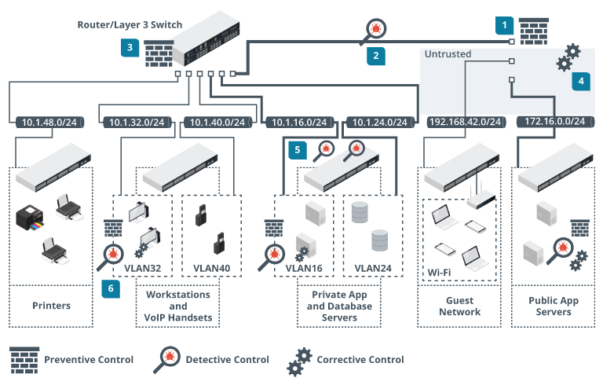
Device Placement
Selection of effective controls
  Enforce segmentation, apply access controls, monitor traffic
Defense in depth
  Zone border (mostly preventive)
  Within zone (mostly detective)
  Endpoint controls (preventive, detective, and corrective)
Notes:
Explain that defense in depth has several aspects:
* Selecting controls to address security at different network layers.
* Placing controls at multiple locations along the network path.
* Selecting controls that perform the full range of preventive, detective, and corrective functions.

Slide 17
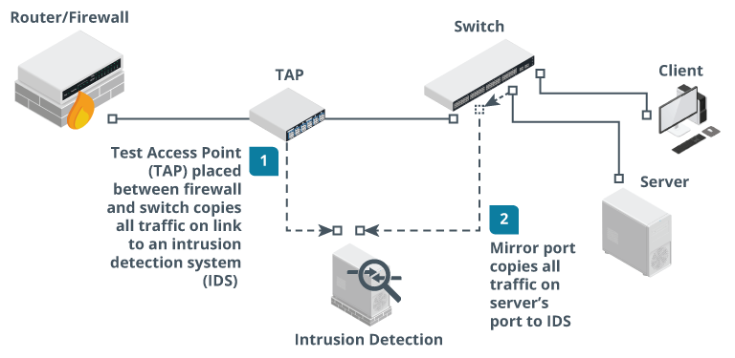
Device Attributes
Active versus passive
  Passive controls don’t require hosts to be configured to use them (and might not be detectable by hosts)
  Active controls require host configuration or software agents
Inline versus tap/monitor
  Inline is installed as part of cable path (“bump-in-the-wire”)
  Switched port analyzer (SPAN) or mirror port
  Test access point (TAP)
Fail-open
  Preserves access on fail to prioritize availability
Fail-close
  Prevents access on fail to priorities confidentiality/integrity
Notes:
Make sure students understand inline placement and active response versus passive detection, alerting, and logging of threats.

Slide 18
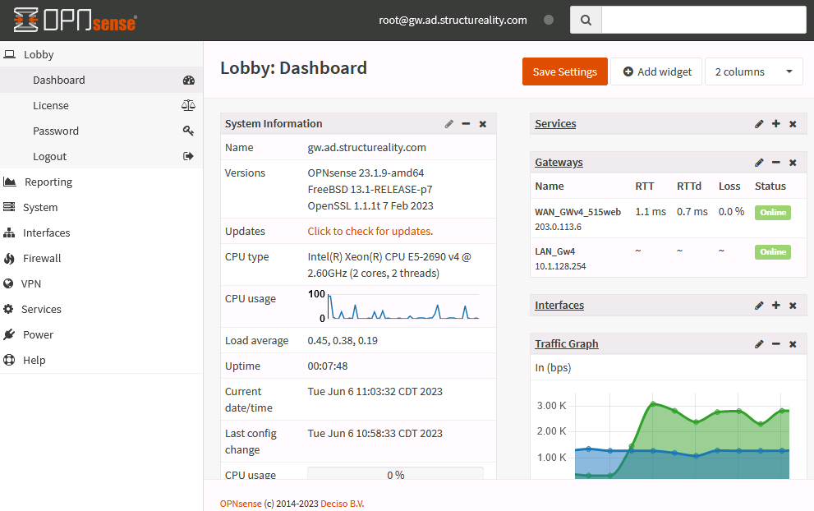
Firewalls
Enforce a network access control list (ACL)
Packet filtering inspects headers only
  Source and destination IP address
  Protocol ID/type (TCP, UDP, ICMP, routing protocols, and so on)
  Source and destination port numbers (TCP or UDP application type)
  Drop/deny/reject or accept/permit a packet (and/or log)
  Inbound, outbound, or both
Placement and attributes
  Routed, bridged, or inline placement
  Firewall appliance versus router firewall
Notes:
Firewalls can be implemented in many different ways. They are often implemented as a function within a product, as well as the dedicated security appliances.

Slide 19
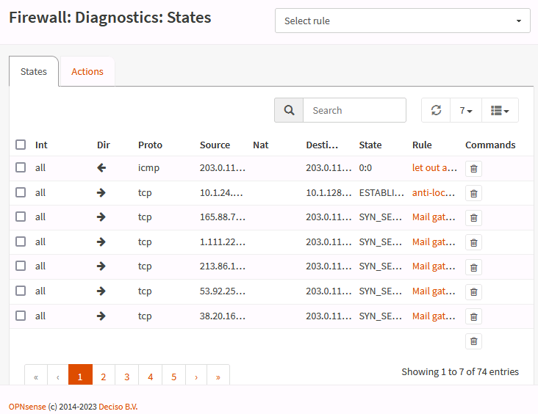
Layer 4 and Layer 7 Firewalls
Stateful inspection validates connections
  State table stores connection
  information
Transport layer (layer 4)
  TCP handshake
  New versus established and related connections
Application layer (layer 7)
  Validate protocol and match threat signatures
  Application layer gateway, stateful multilayer inspection, or deep packet inspection
  Application-specific filtering
Screenshot used with permission from Rubicon Communications, LLC
Notes:
Note that very few, if any, firewalls are wholly stateless anymore. The principal distinction is between firewalls that track the state at the transport layer and those that can monitor application sessions.

Slide 20
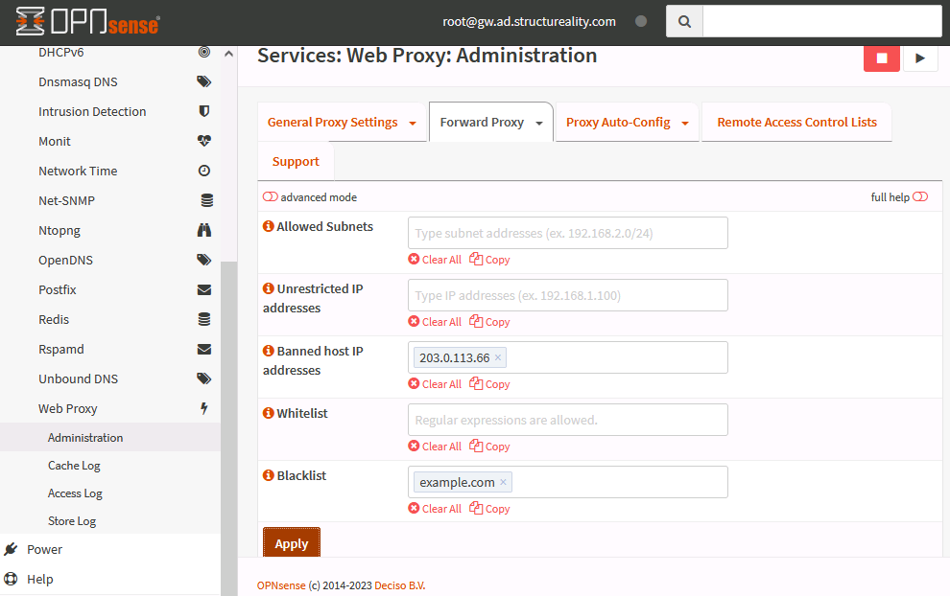
Proxy Servers
Forward proxy server
  Proxy opens connections with external servers on behalf of internal clients
  Application-specific filters
  Non-transparent and transparent proxies
  User authentication
Reverse proxy server
  Proxy opens connections with internal servers on behalf of external clients
Notes:
Point out that many proxy servers are used to implement application-layer firewalls, but they can also improve client performance (through a caching engine).

Slide 21
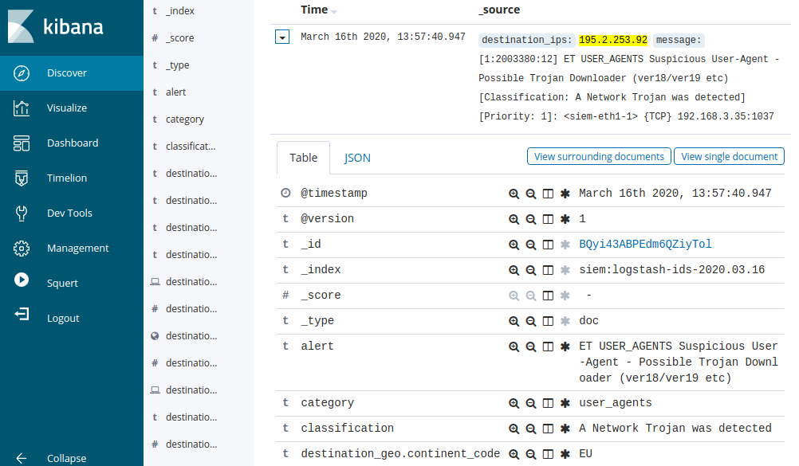
Intrusion Detection Systems
Sensor captures traffic
  Placement
  Inline versus mirror/tap/monitor
Intrusion Detection System (IDS)
  Detection engine performs real-time analysis of indicators
  Passive logging/alerting
Intrusion Prevention System (IPS)
  Active response (block, reset, redirect)
  Inline response versus integration with other security tools
Screenshot Security Onion securityonion.net
Notes:
IDS has developed into IPS and merged with firewall and antivirus/antispyware software. The systems are not as limited by network and host bandwidth as they were a few years ago. For the exam, however, you should stress the difference. It is important to realize that a pure IDS will only provide a passive response.

Slide 22
Next-generation Firewalls and Unified Threat Management
Next-generation firewall
  Application-aware filtering, user account-based filtering, IPS, cloud inspection, …
Unified threat management (UTM)
  Combining security controls into single agent and management platforms
  Firewall, anti-malware, network intrusion prevention, spam filtering, content filtering, data loss prevention, VPN, cloud access gateway, …
Notes:
Encourage students to use both market research and vendor sites to navigate the various product classifications.

Slide 23
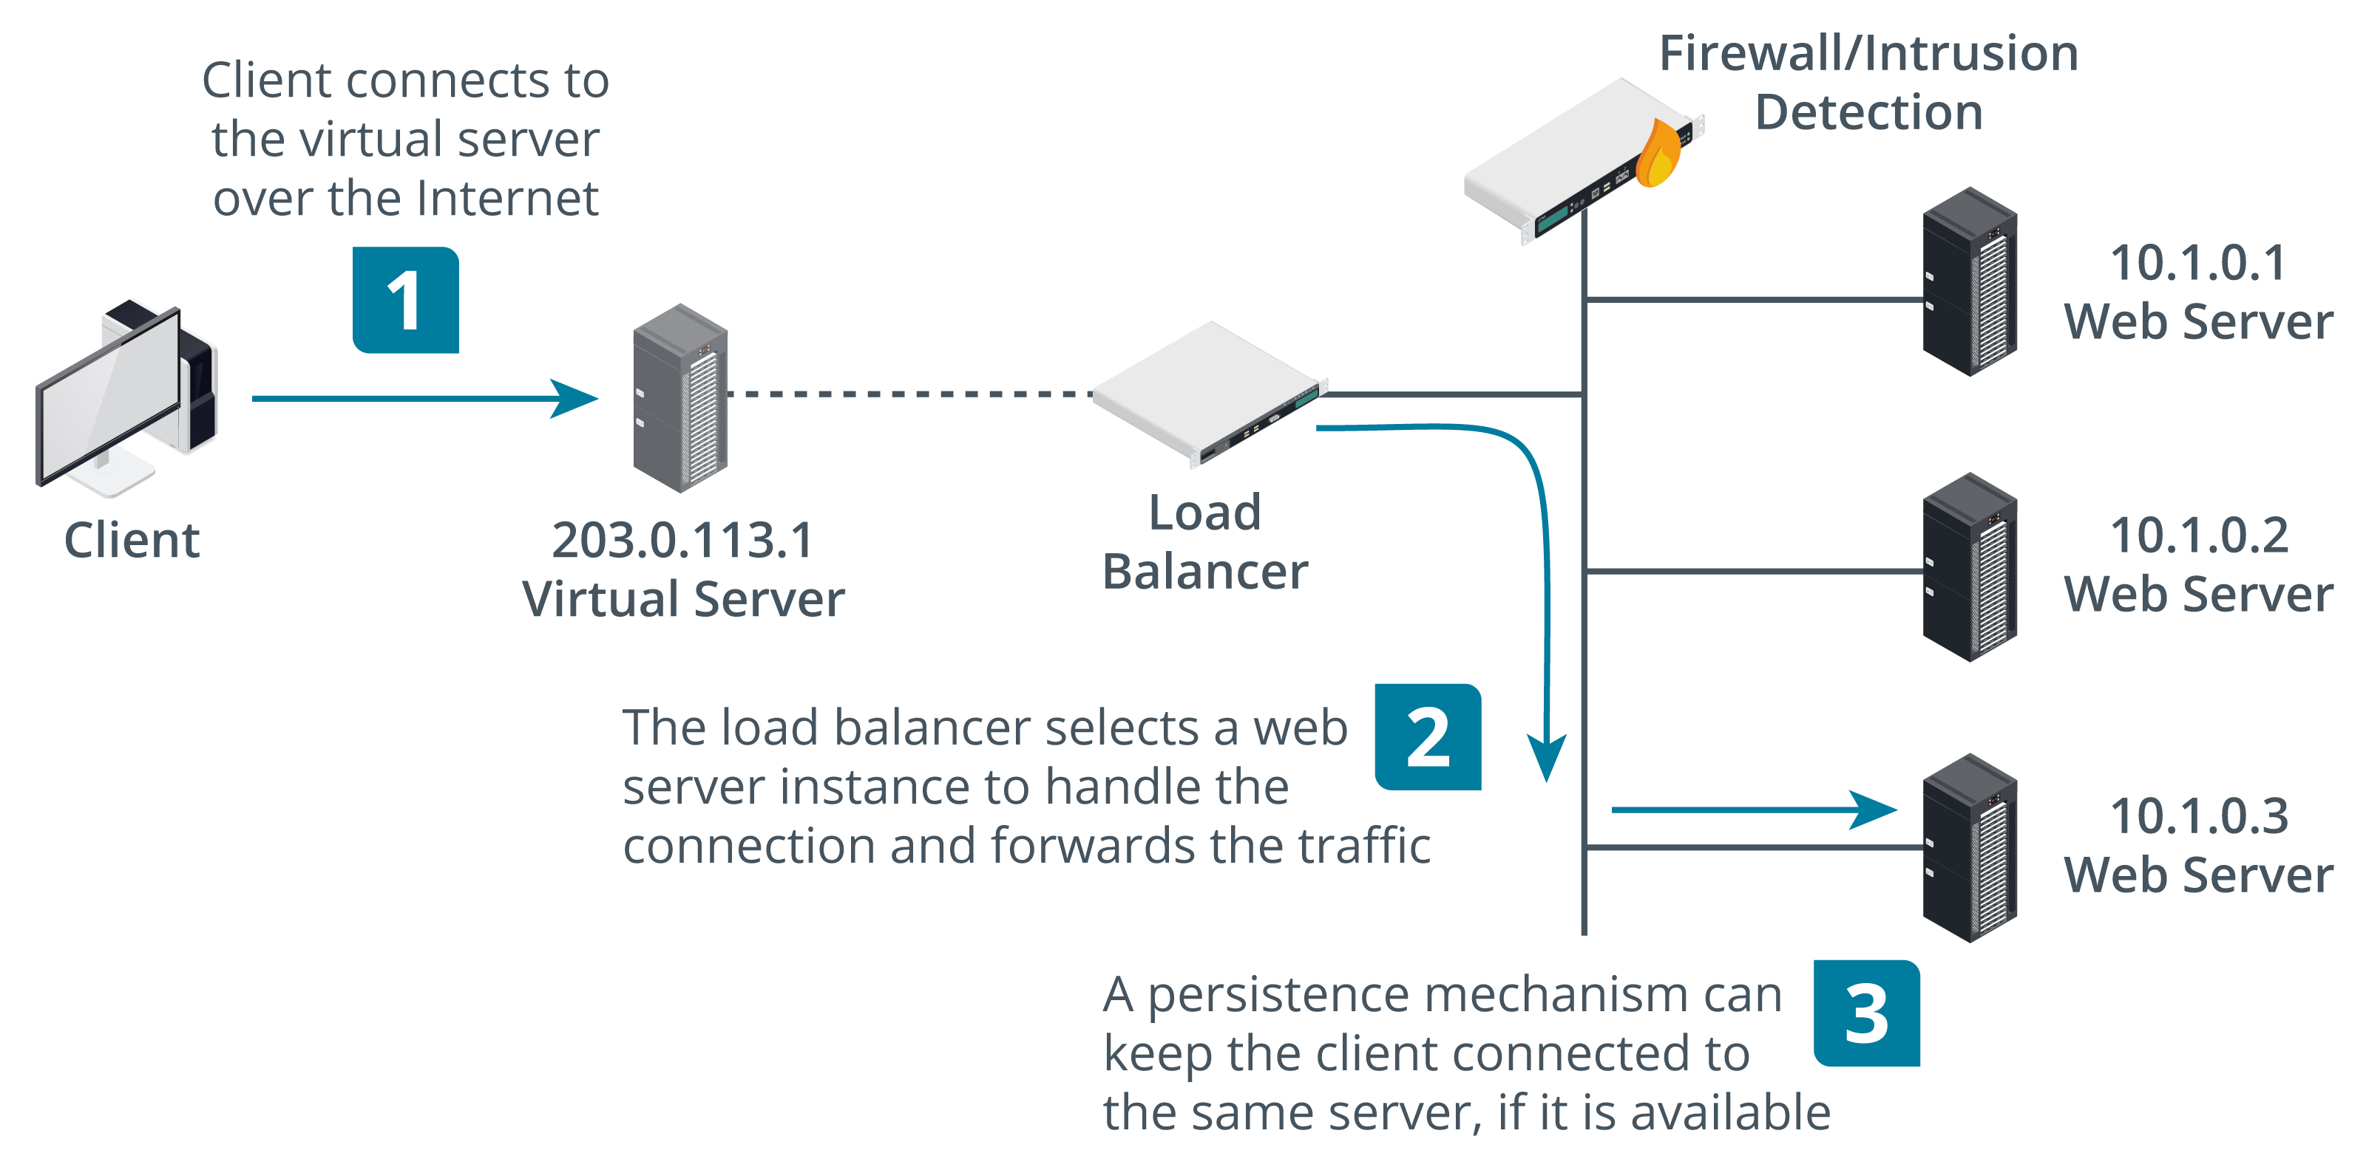
Load Balancers
Distributes requests across farm or pool of servers (nodes)
  Layer 4 load balancer
  Layer 7 load balancer (content switch)
Scheduling
  Round robin
  Fewest existing connections / best response time
  Weighting
  Heartbeat and health checks
Source IP affinity
Session persistence
Images © 123rf.com.

Slide 24
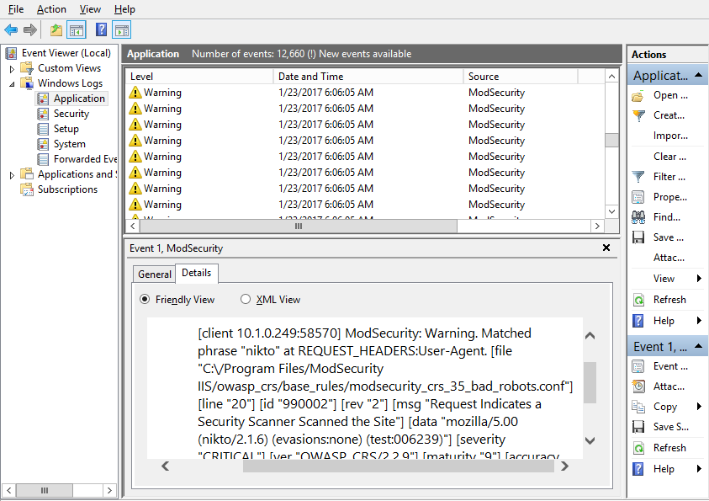
Web Application Firewalls
Able to inspect code in HTTP
packets
Matches suspicious code to
vulnerability database
Can be implemented as software
on host or as appliance
Screenshot used with permission from Microsoft.
Notes:
We'll be turning to web application security in more detail later in the course. Just make sure students can distinguish the function of a WAF from more general network firewall/IDS types.

Slide 25
Network Security Appliances
Device placement
  Defense in depth plus use of preventive, detective, and corrective controls
Device attributes
  Active versus passive, inline versus TAP/monitor, fail-open versus fail-closed
Firewalls (layer 4/7)
Proxy servers
Intrusion detection systems
Next-generation firewalls and unified threat management
Load balancers
Web application firewalls

Slide 26
Virtual Private Networks
Lesson 5
Topic 5C
Notes:
Students can find VPN and IPsec concepts challenging, so allocate plenty of time to this topic.

Slide 27
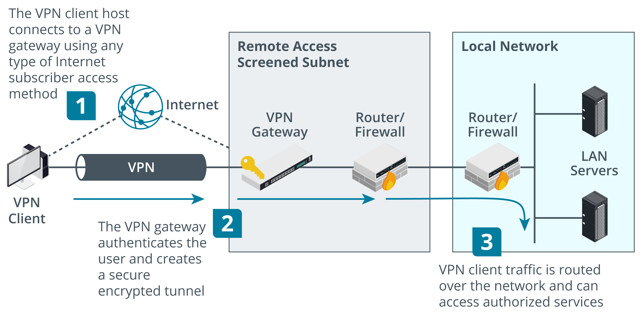
Remote Access Architecture (1)
Images © 123RF.com.
Notes:
According to some definitions, a VPN need not be secure. However, this is what most people understand as a VPN these days.

Slide 28
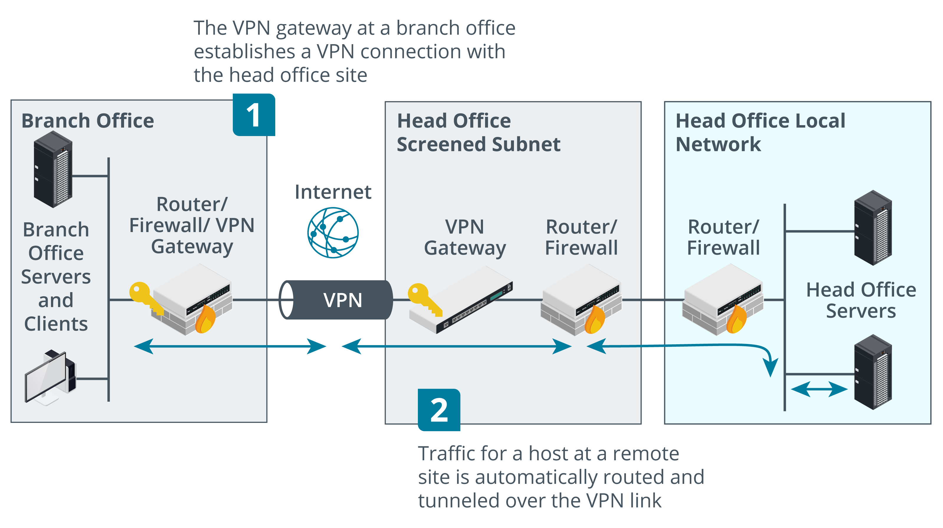
Remote Access Architecture (2)
Images © 123RF.com.

Slide 29
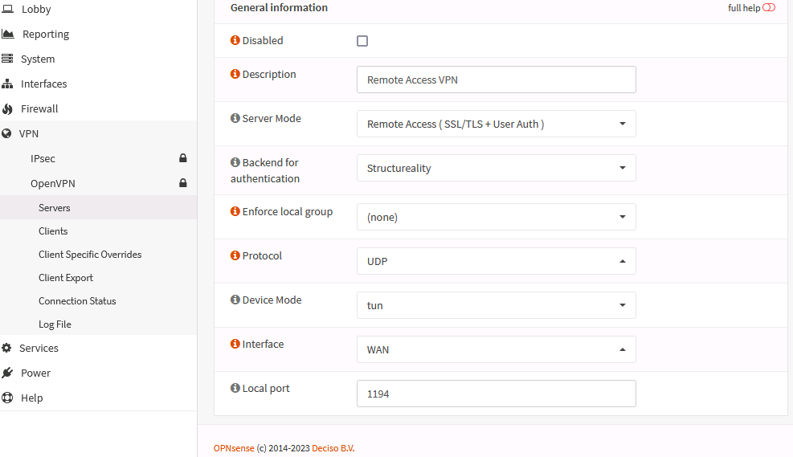
Transport Layer Security Tunneling
Use TLS to negotiate a secure connection
  Machines authenticated by PKI certificates
    Mutual authentication allows VPN gateway to authenticate client certificates
  User account authentication via RADIUS
Tunnel network traffic over TLS
Can use TCP or UDP
Screenshot used with permission from Rubicon Communications, LLC.
Notes:
Explain that the important point about modern VPNs is to hide any authentication information from eavesdroppers. Protocols such as PPTP do not protect the hash exchanged during the CHAP/MSCHAP handshake, making the connection extremely vulnerable to offline cracking attempts.

Slide 30
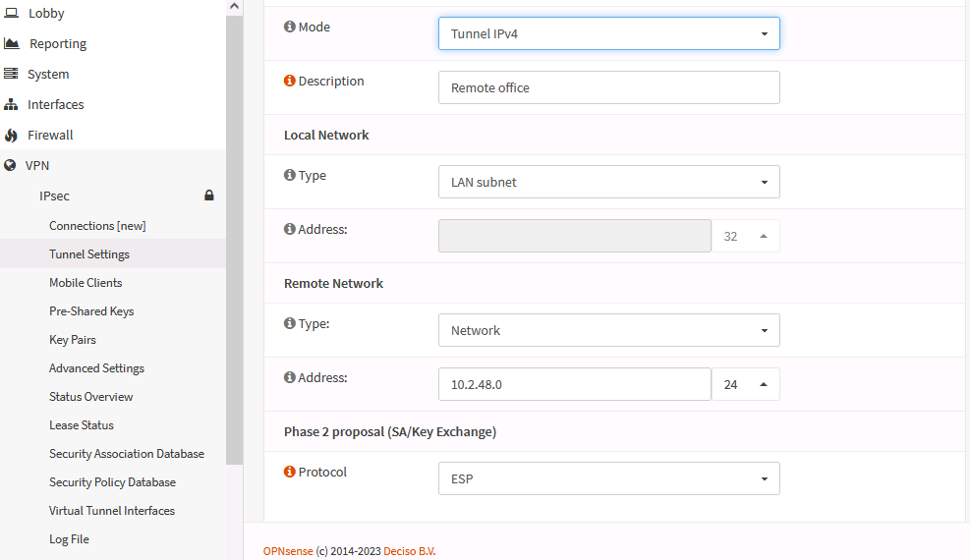
Internet Protocol Security Tunneling
Provides confidentiality and/or integrity
  Authentication Header (AH)
    Signs packet but does not encrypt payload
    Provides authentication/integrity only
  Encapsulation Security Payload (ESP)
    Provides confidentiality and/or authentication/integrity
Modes
  Transport mode for host-to-host connections on a private network
  Tunnel mode between gateways across an unsecure network
Screenshot used with permission from Rubicon Communications, LLC.
Notes:
Explain the difference between the two modes and how they relate to VPN topologies:
* Transport mode is used for host-to-host topologies.
* Tunnel mode is used for site-to-site and remote access VPN topologies.

Slide 31
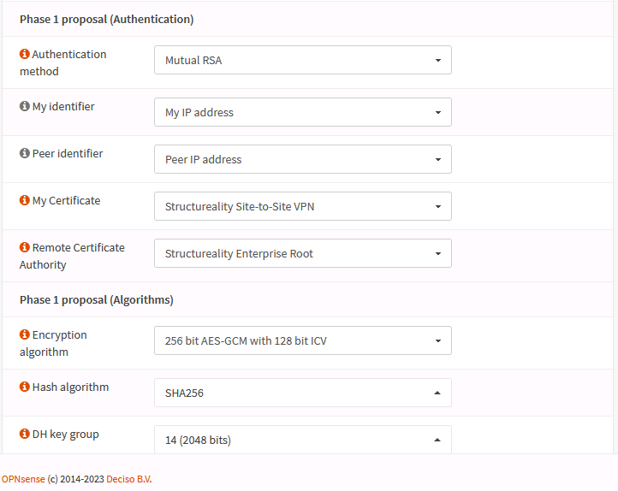
Internet Key Exchange
Establishes Security Association (SA) between peers
Phase I provides authentication
  PKI/certificates
  Pre-shared key
Phase II establishes cipher suites
and key sizes and use of AH or ESP
IKE v1 supports host-to-host and site-to-site tunneling
IKE v2 adds better support for client-to-site remote access VPN
Screenshot used with permission from Rubicon Communications, LLC.
Notes:
IKE isn't a specific subobjective, but it is critical to the operation of IPsec, so worth covering.
IKEv1 could only be used with another protocol (L2TP) for remote access VPNs. IKEv2 supports EAP/RADIUS architecture and so can be used on its own as a remote access VPN solution.

Slide 32
Remote Desktop
GUI-based remote terminal software
Remote Desktop Protocol (RDP)
  Connect to physical machines
  RDP gateway to virtual desktops and apps
HTML5/clientless
  Access desktops and web applications from Internet via gateway to internal network
  Browser support for canvas element plus WebSockets
Notes:
Explain the difference between remote access VPN and remote access host management. Rather than connecting a remote client to a local network, an RDP solution provides access to a real or virtual desktop or app within the local network. Rather than tunneling all network traffic from a remote client, they tunnel the HID traffic in and the audio/video out.

Slide 33
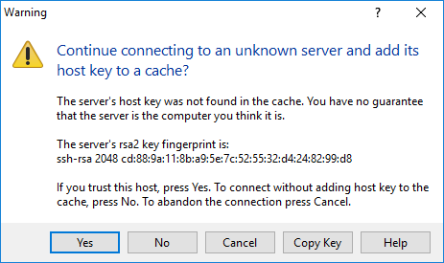
Secure Shell
Remote administration with public key cryptography security
Host key identifies server
Client authentication
  Username/password
  Public key authentication
  Kerberos
Key management
SSH commands
  ssh versus scp (Secure Copy)
Screenshot used with permission from PuTTY.
Notes:
SSH is primarily for UNIX/Linux, though there are Windows versions. Windows can also use the proprietary Windows Remote Management (WinRM) and Windows Remote Shell (WinRS).
Make sure students understand the difference between identifying a server via its host key and connecting to the server using a client public key.

Slide 34
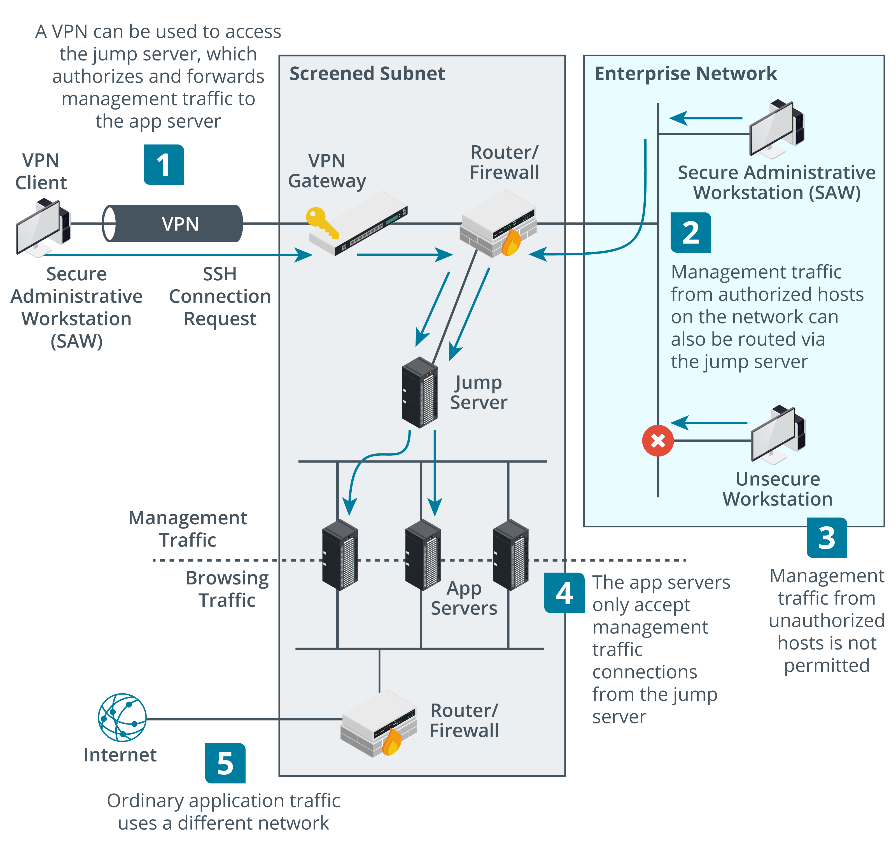
Out-of-band Management and Jump Servers
Secure admin workstations (SAWs)
Out-of-band (OOB) management
  Serial/modem/console port
  Virtual terminal
  Separate cabling or VLAN isolation
Jump servers
  Single host accepts SSH or RDP connections from SAWs
  Forwards connections to app servers
  App servers only accept connections from jump server
Images © 123rf.com.
Notes:
You might want to point out another use case for jump servers to provide multiple hops through to back-end servers in the cloud.

Slide 35
Virtual Private Networks
Remote access architecture
  Tunneling, client-to-site remote access VPN, site-to-site VPN
Transport Layer Security (TLS) tunneling
Internet Protocol Security (IPSec) tunneling
Internet Key Exchange
Remote Desktop
Secure Shell
Out-of-band management and jump servers

Slide 36
Assisted Lab: Setting up Remote Access
Assisted Lab: Using IPSec Tunneling

Slide 37
Summary
CompTIA Security+ Exam SY0-701
Lesson 5
Notes:
Check that students are confident about the content that has been covered. If there is time, revisit any content examples that they have questions about. If you have used all the available time for this lesson block, note the issues and schedule time for a review later in the course.

